Slide 1
Rowing boat project
A 15 foot recreational rowing boat for use by a single rower or a single rower plus a passenger

Slide 2
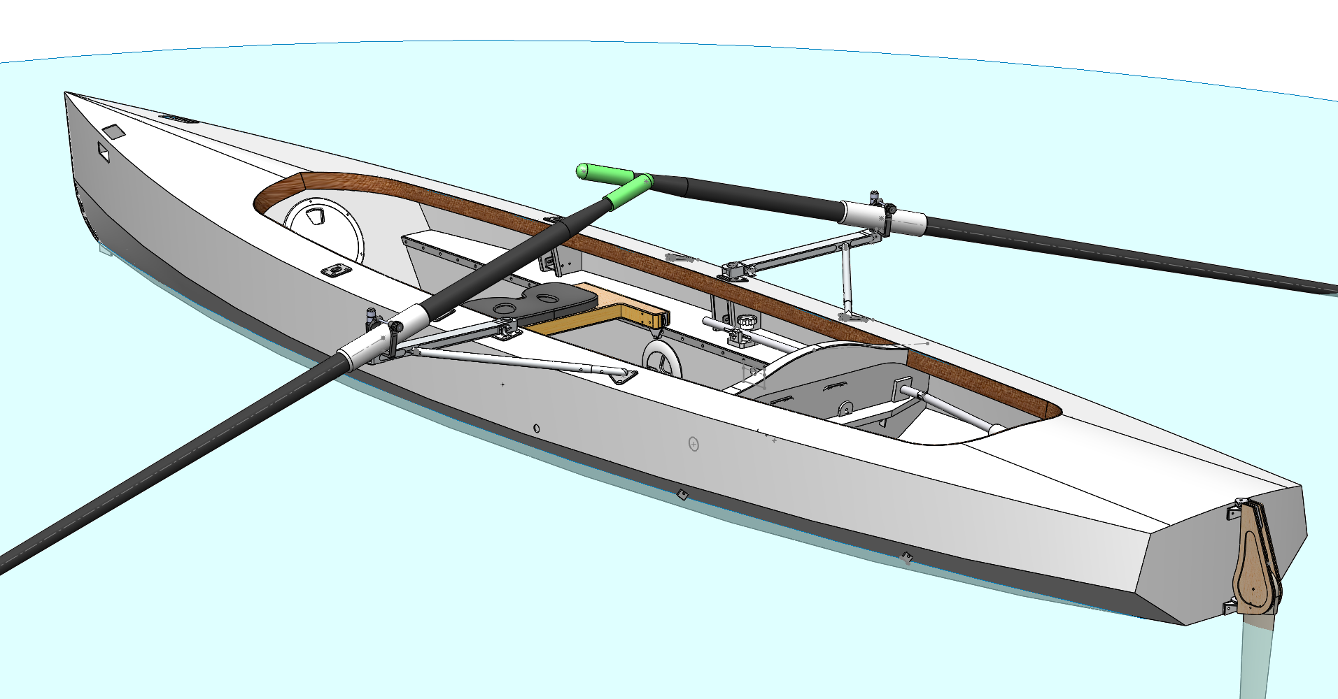
Many options were sketched using 3D design software (Solidworks). I spent a lot of time viewing the boat on the screen from all angles to get the aesthetics right – at least to get them right for me, this is a subjective thing and someone else might not like the result.

Slide 3
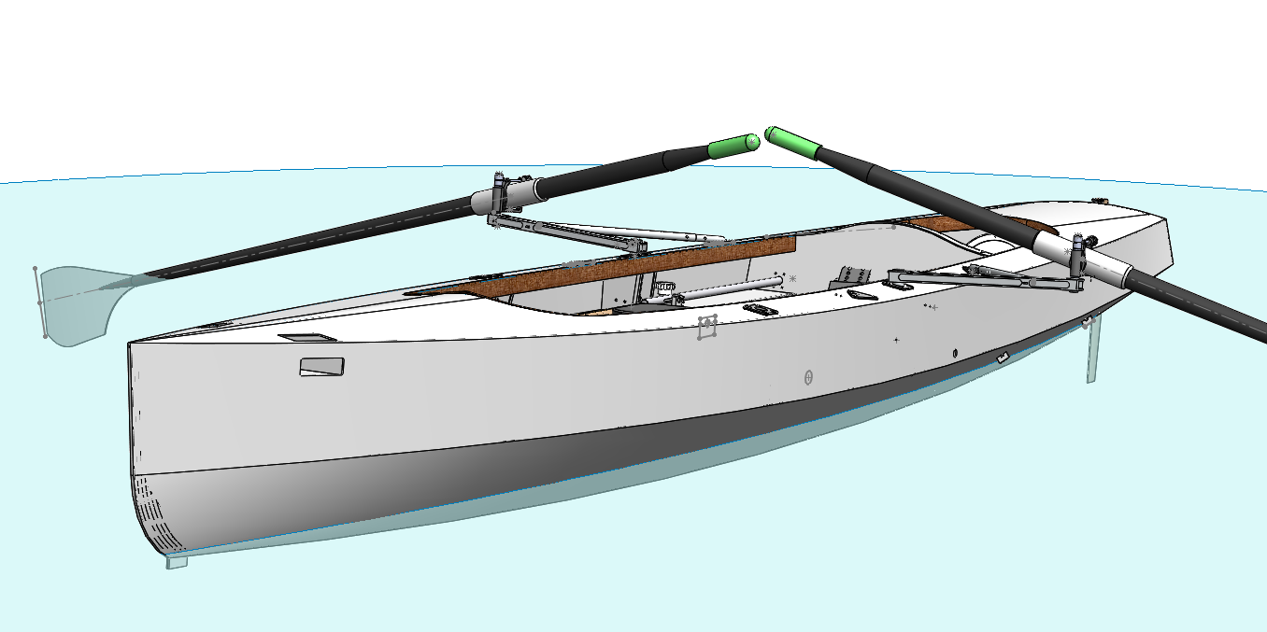
Steering control knob
Modern software allows working mechanisms to be included in a 3D drawing. As an example of this the little control knob marked with an arrow is linked to the rudder and turning the knob on the screen using the computer mouse actually operates the mechanism and turns the rudder.

Slide 4

Automatic ‘nesting’ of all the 3mm marine plywood parts – 5 standard sheets – includes all plywood parts - rudder, launch trolley, seats etc.

Slide 5
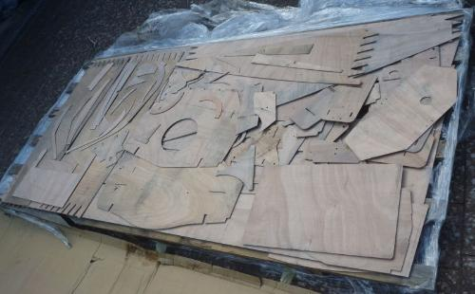
All the plywood parts waterjet cut by Luffman Engineering, Tiverton.
3mm marine plywood. Note - the water in the cutting machine gets dirty and stains the wood so no good for a bright varnish finish

Slide 6
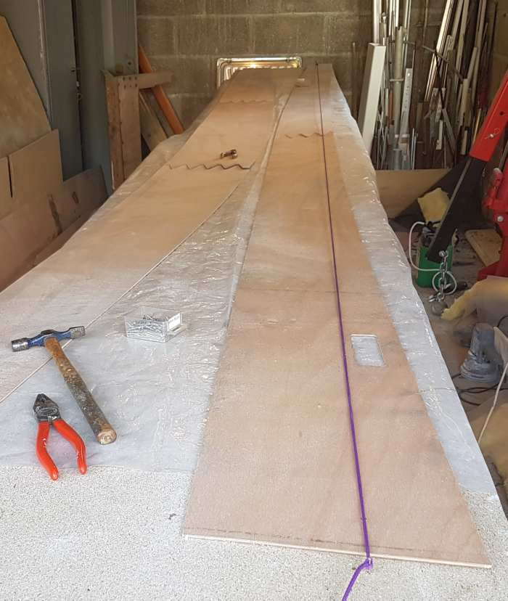
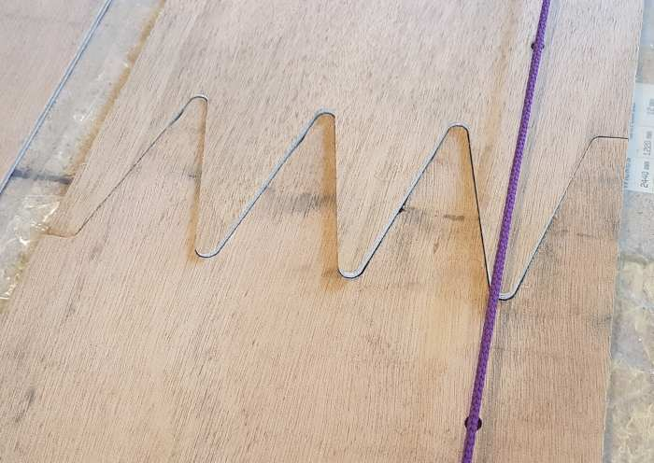
Marker holes
Finger joint alignment
Small marker holes were included in the waterjet cutting file so that the panels could be lined up with a (purple) string stretched across the centre of the holes. The cutting file also included all the fastener holes needed for attaching fittings to the boat, so much easier than aligning fittings at a later stage.

Slide 7
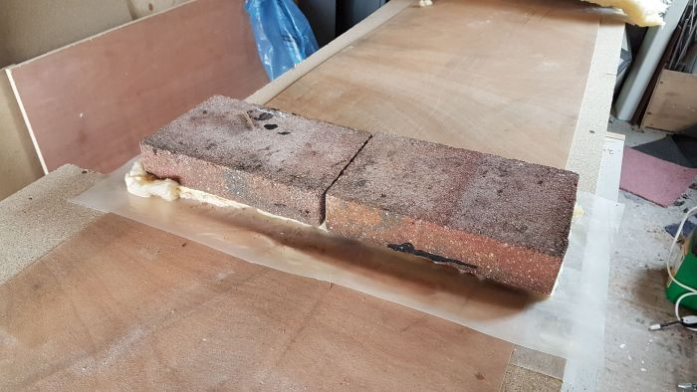
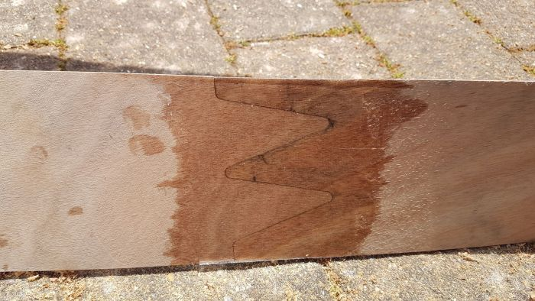
Finger joint gluing
One layer of thin glass cloth and epoxy on the inside surface only – the outside surface will be sheathed along with the rest of the hull exterior.
Thick gauge polythene sheet is peeled off after resin has cured.

Slide 8
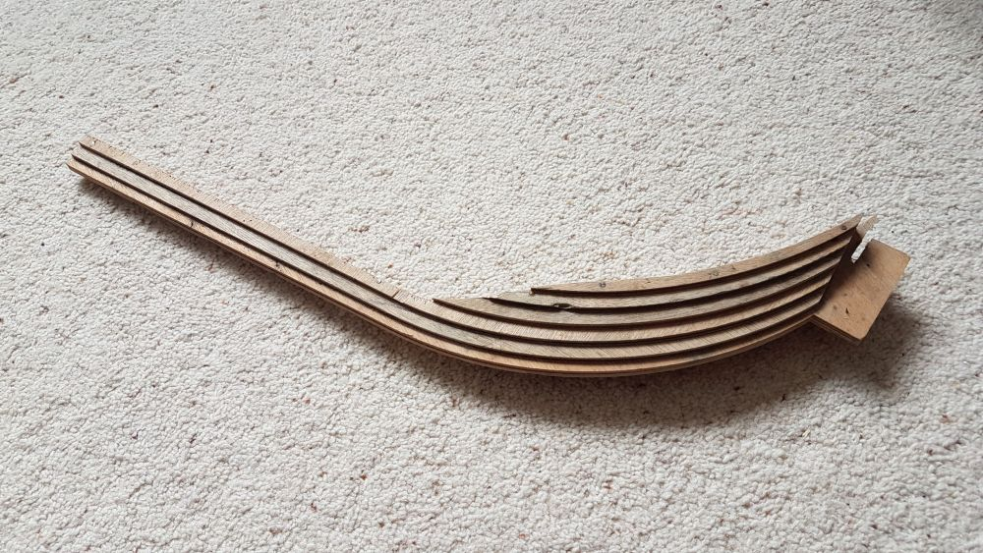
Stem timber assembled from waterjet cut plywood laminations – angle grinder used to remove the ridges to leave exactly the correct shape

Slide 9
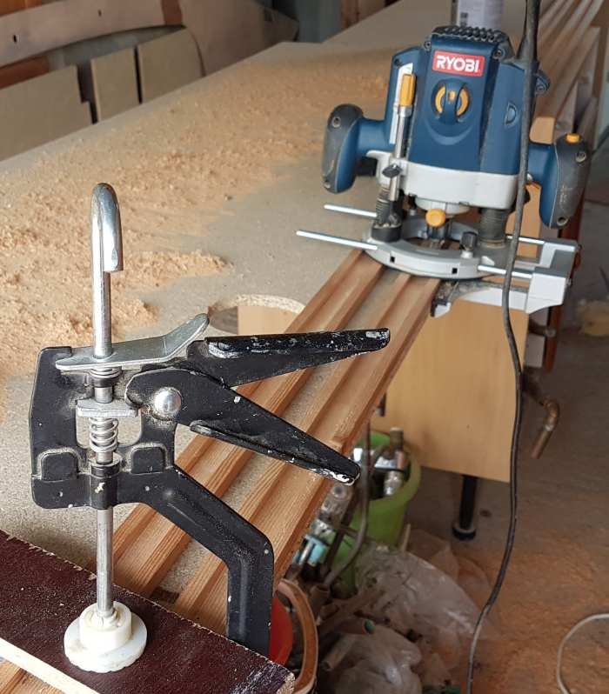
Using router to make timbers into channel sections to save weight
(not much weight saved, but it all helps)

Slide 10
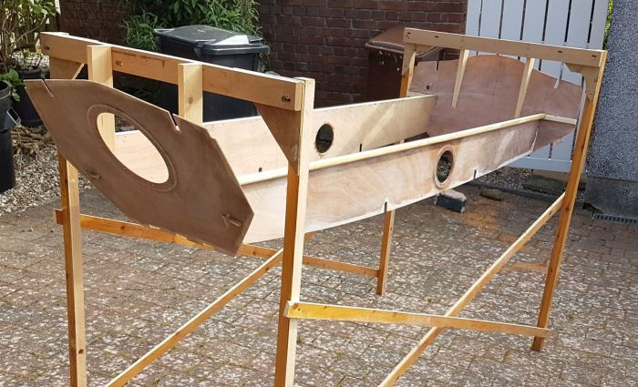
A purpose made frame was constructed to support the boat during assembly, this was a waste of time since it was found that assembly was easier just using a temporary flat work bench assembled from scrap pieces of chipboard. No ‘building jig’ was necessary.

Slide 11
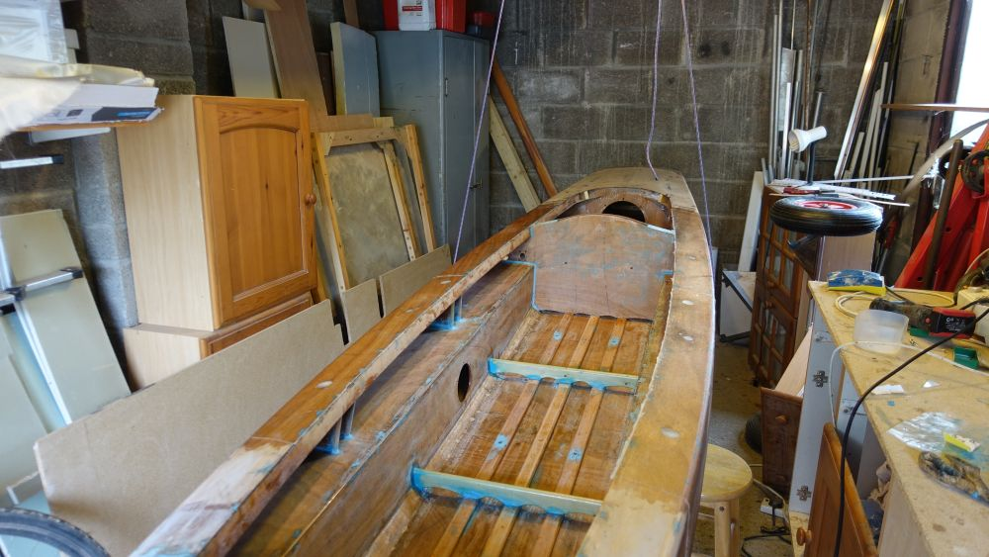
Showing a loop of cord to support boat at any roll angle during construction – this worked well. Bow rested on a trestle, or two cord loops could have been used.
(garage is now tidier than it was then!)

Slide 12
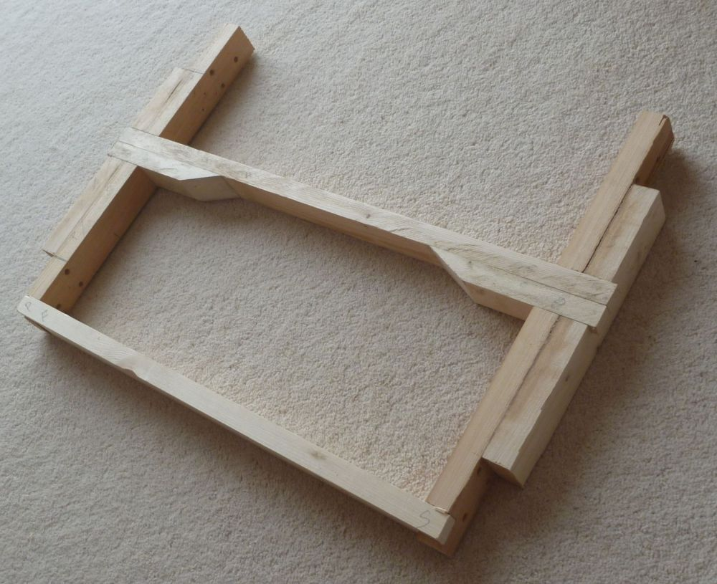
Frame for sliding seat – some of this timber is actually hollowed out to save a bit of weight

Slide 13
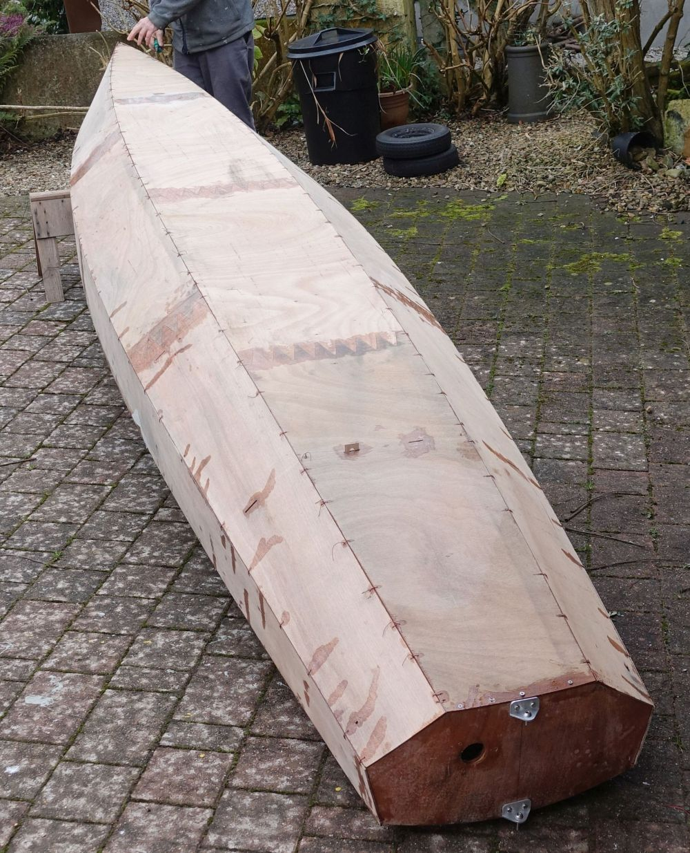
Hull panels all stitched together
Now ready for seams to be completed with strips of 45/45 degree glass on the inside then an all over sheathing of light glass cloth applied to the hull exterior.
The plywood stitching is with copper wire extracted from a scrap transformer.

Slide 14
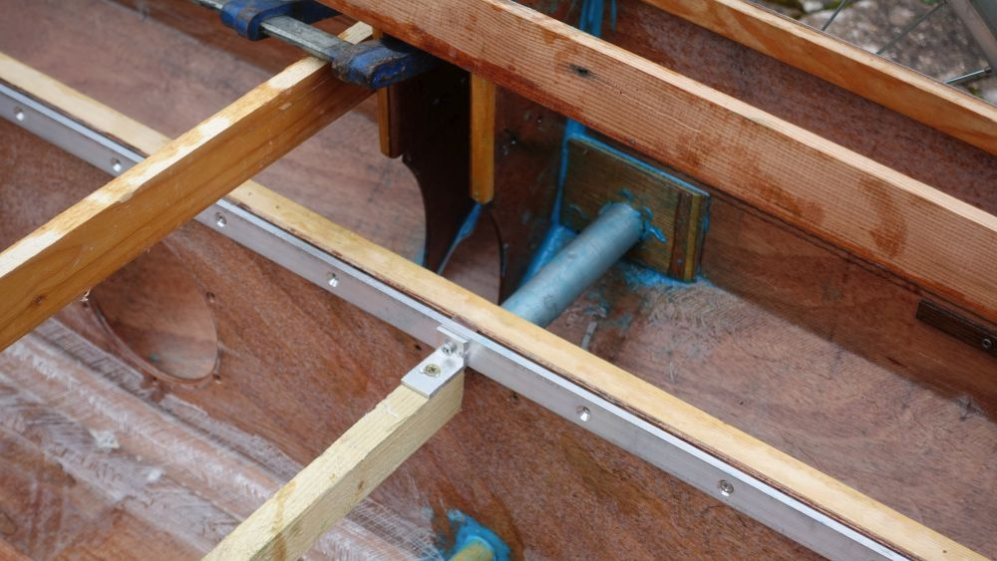
Receptacle for wheel axle (blueish color tube)
Also showing aluminium rail for sliding seat and temporary hull bracing
(the blue color is an epoxy filler supplied by Reactive Resins Ltd., Cornwall)

Slide 15
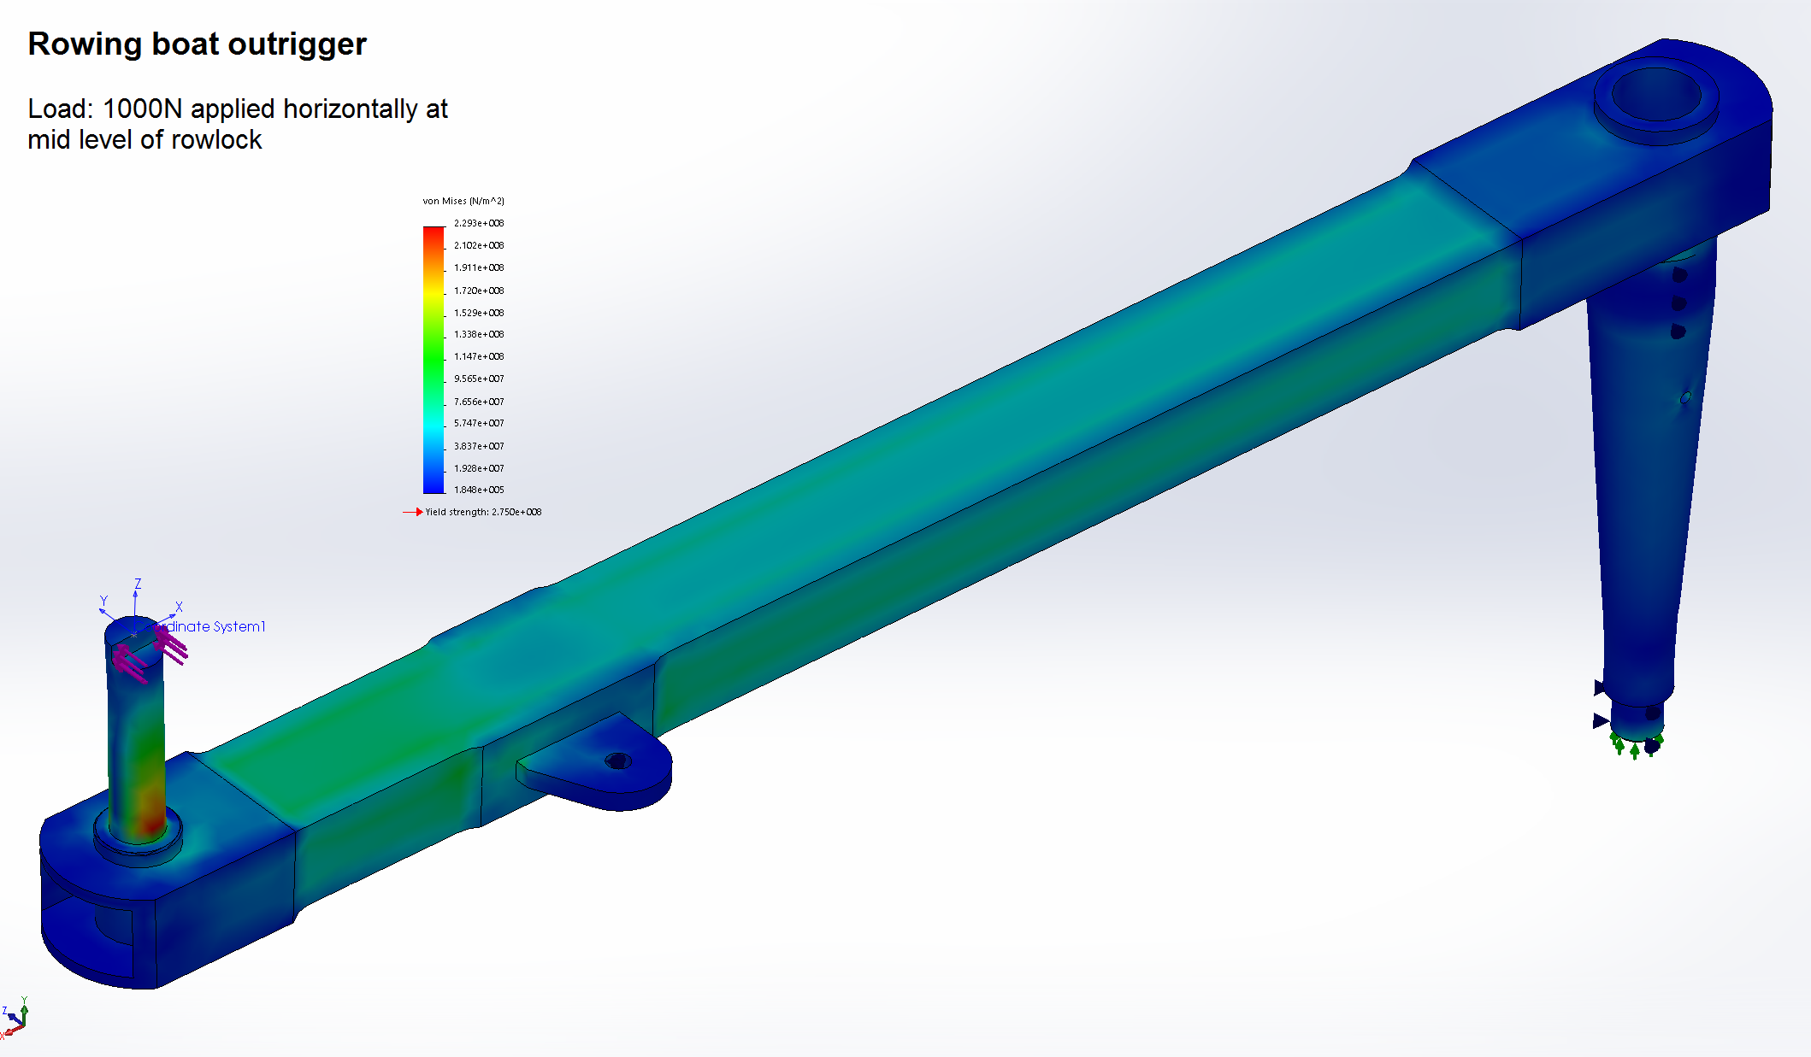
The quick folding outriggers are a useful feature of the design. The oars stay in the rowlocks when the outriggers are folded in and the folded in outriggers and oars do not obstruct the interior of the boat.
Above shows finite element analysis for the folding outrigger arm
The arm is loaded in torsion by horizontal force applied to the rowlock
It was found that the highest stress was due to bending moment in the rowlock pin, the aluminium fabrication had strength in reserve. Hence the arm was lightened by machining to reduce the wall thickness but full wall thickness was retained in proximity to welds.

Slide 16
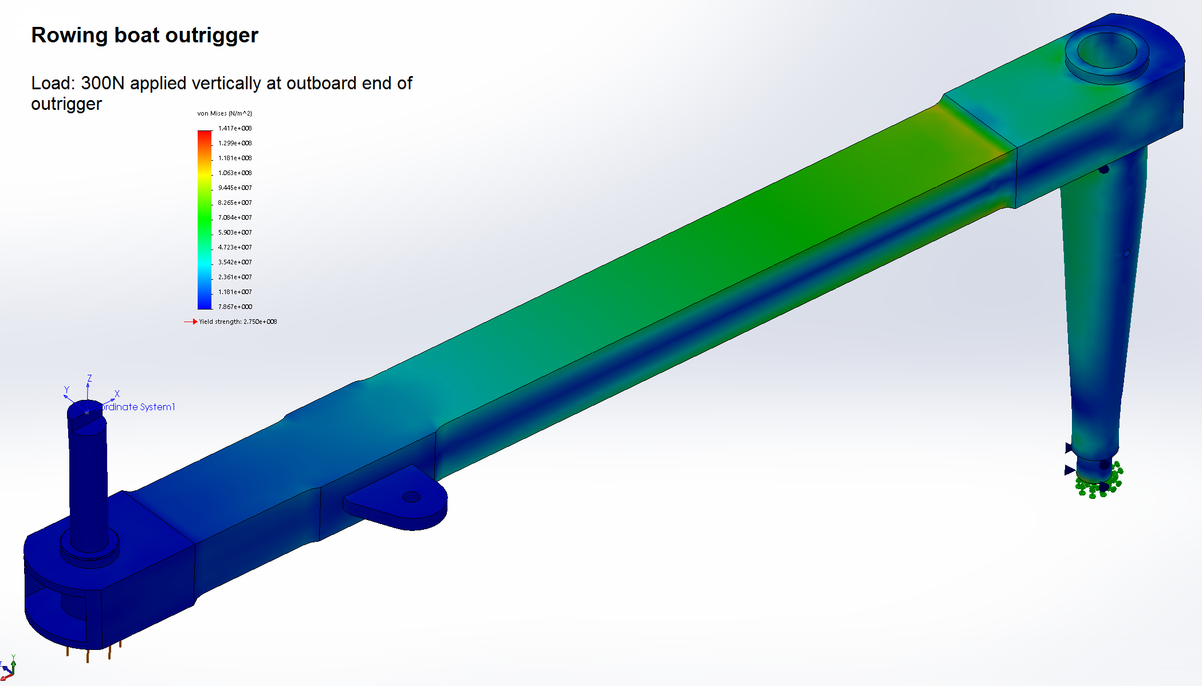
A check was made that lifting the boat by the outboard end of the rowlock outriggers would not cause excessive stress in the outriggers. This shows that a load well in excess of half the weight of the boat applied to the outboard end of an outrigger arm would not cause yield of the 6082T6 alloy, but even so we prefer not to lift the boat this way.

Slide 17
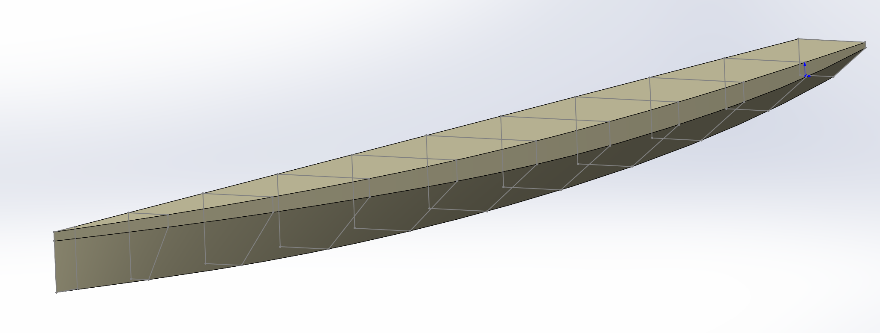
This simplified half model of the row boat hull was used to generate offsets for the Michlet drag prediction software
The bow has been simplified with a vertical stem rather than a slightly raked stem and curved forefoot
The topsides have been truncated since regions that are not immersed are irrelevant to water drag

Slide 18
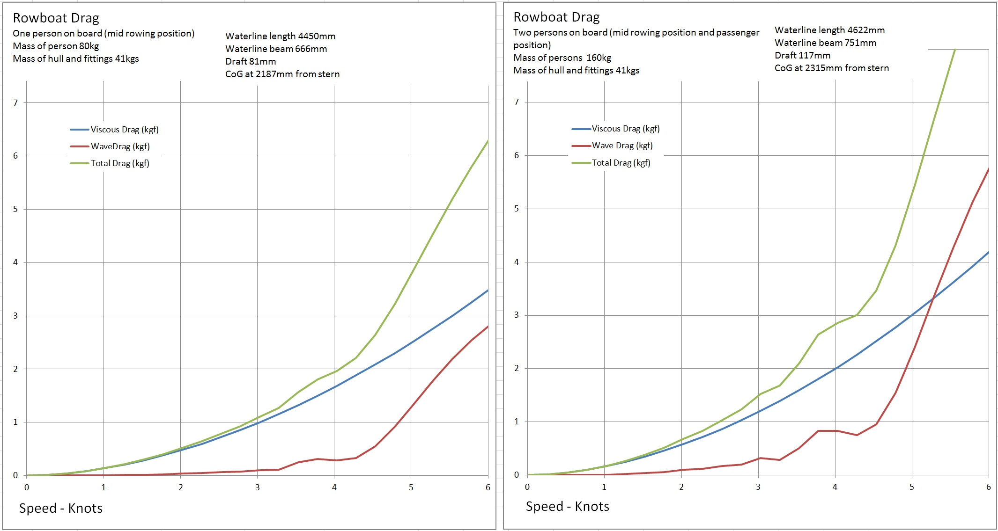
Drag predictions from Michelet software. Michelet predicts viscous drag from standard skin friction data widely used by naval architects (the ITTC line). Wave drag is predicted using an ideal flow analysis based on Mitchells integral
see www.maths.adelaide.edu.au/yvonne.stokes/Tuck/pdfiles/laz_tuc_ictam.pdf

Slide 19
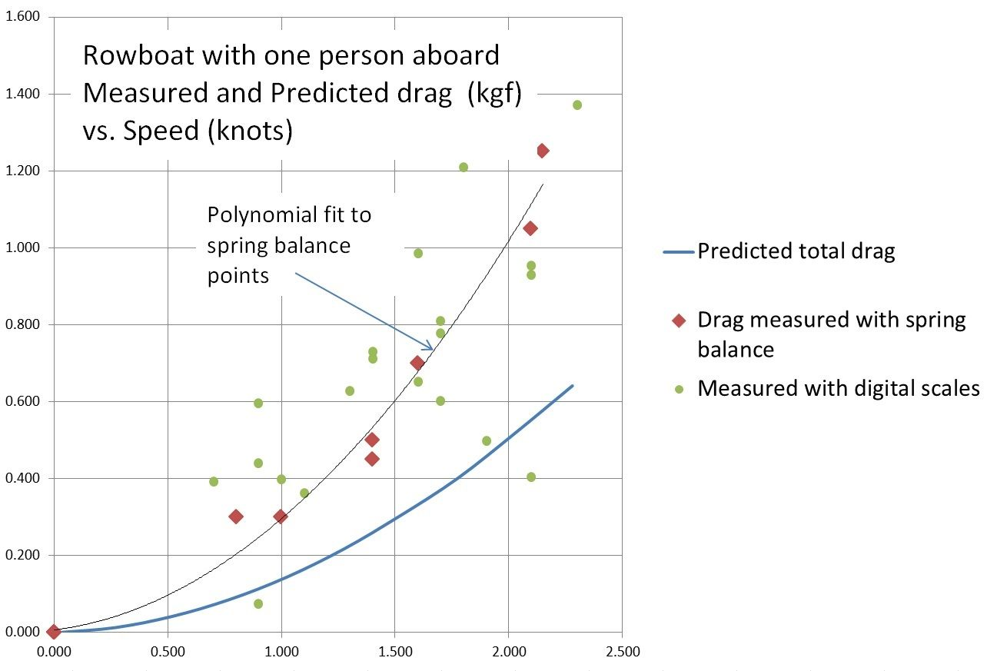
The measured drag is considerably higher than the predicted drag and it fluctuated widely even at steady speed. The reason(s) is not clear, it may be that the towrope was too short so that prop wash from the tow boat influenced the results

Slide 20
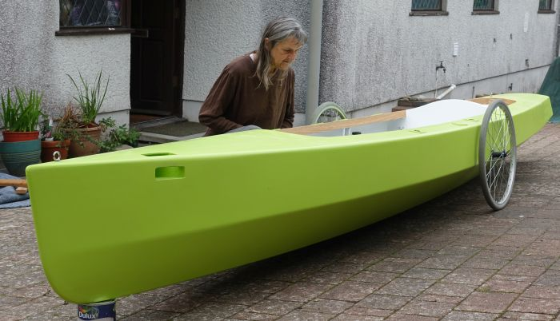
Josephine inspects her new boat - the clip on wheels (wheel chair wheels) have proved to be very handy so the conventional launching trolley that was made for the boat has rarely been used.

Slide 21
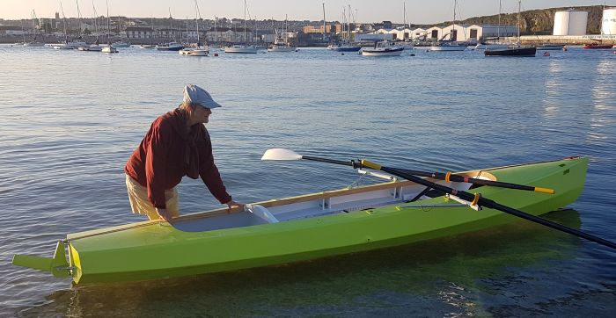
First launch - (Mountbatten our nearest slipway to home)
The rudder blade proved to be too small and a larger one had to be made, otherwise the boat worked well from the start
This shows the outriggers in the forward position to row with a passenger, the outriggers can be moved aft to row without a passenger

Slide 22
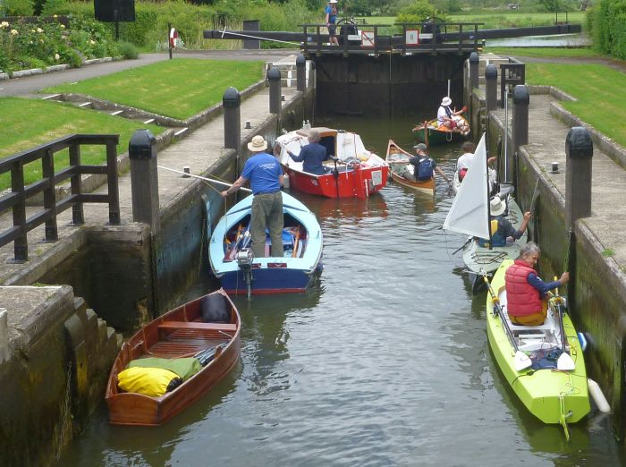
The HBBR Thames Row – Lechlade to Beale Park (near Pangbourne) – an event primarily for home built boats, although no one minded that a few of the fleet were not home built.

Slide 23
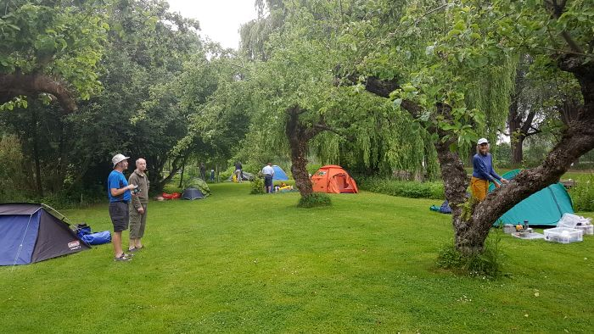
Lock side camping – we brought the quick to set up green pop-up tent (right, behind tree) and the plastic boxes specially for use with this row boat, all stows neatly on board.

Slide 24
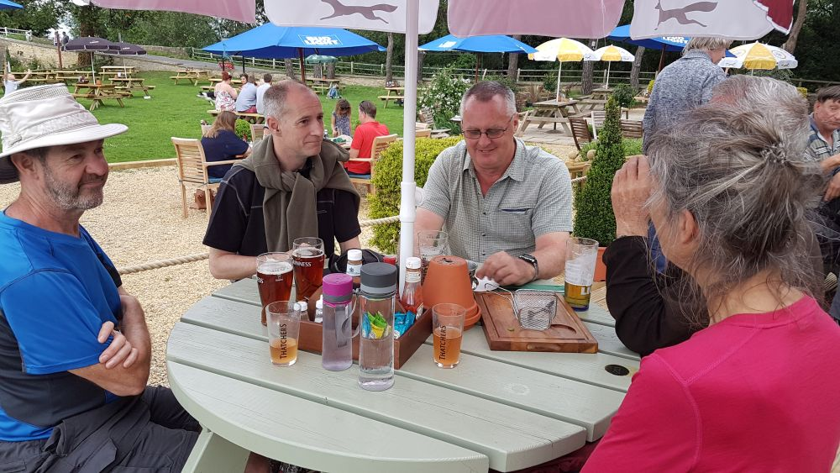
This is how we spent most evenings (Swan Inn)

Slide 25
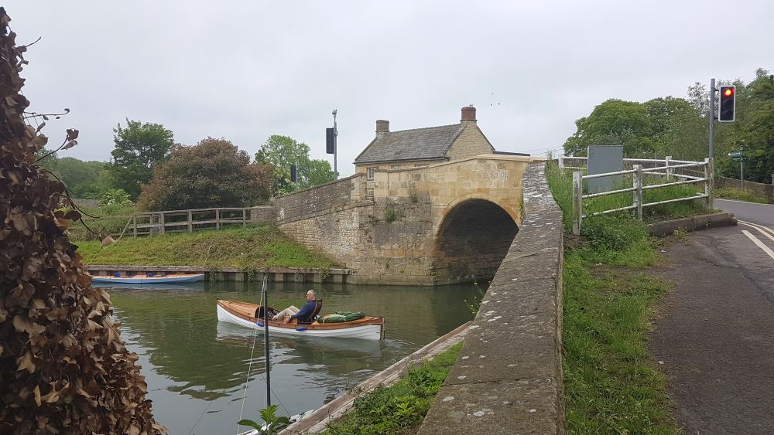
Tim O’Connor’s fine pedal boat (near Swan Inn)

Slide 26
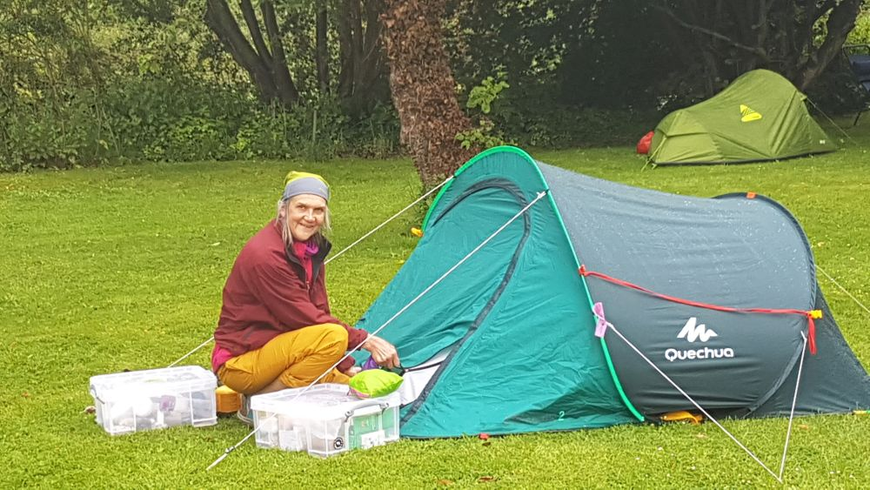
Camping at Shifford Lock

Slide 27
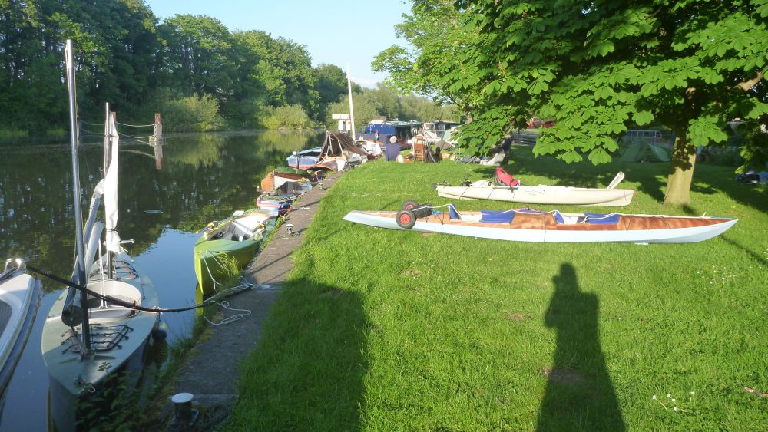
Some of the fleet at Abingdon lock

Slide 28
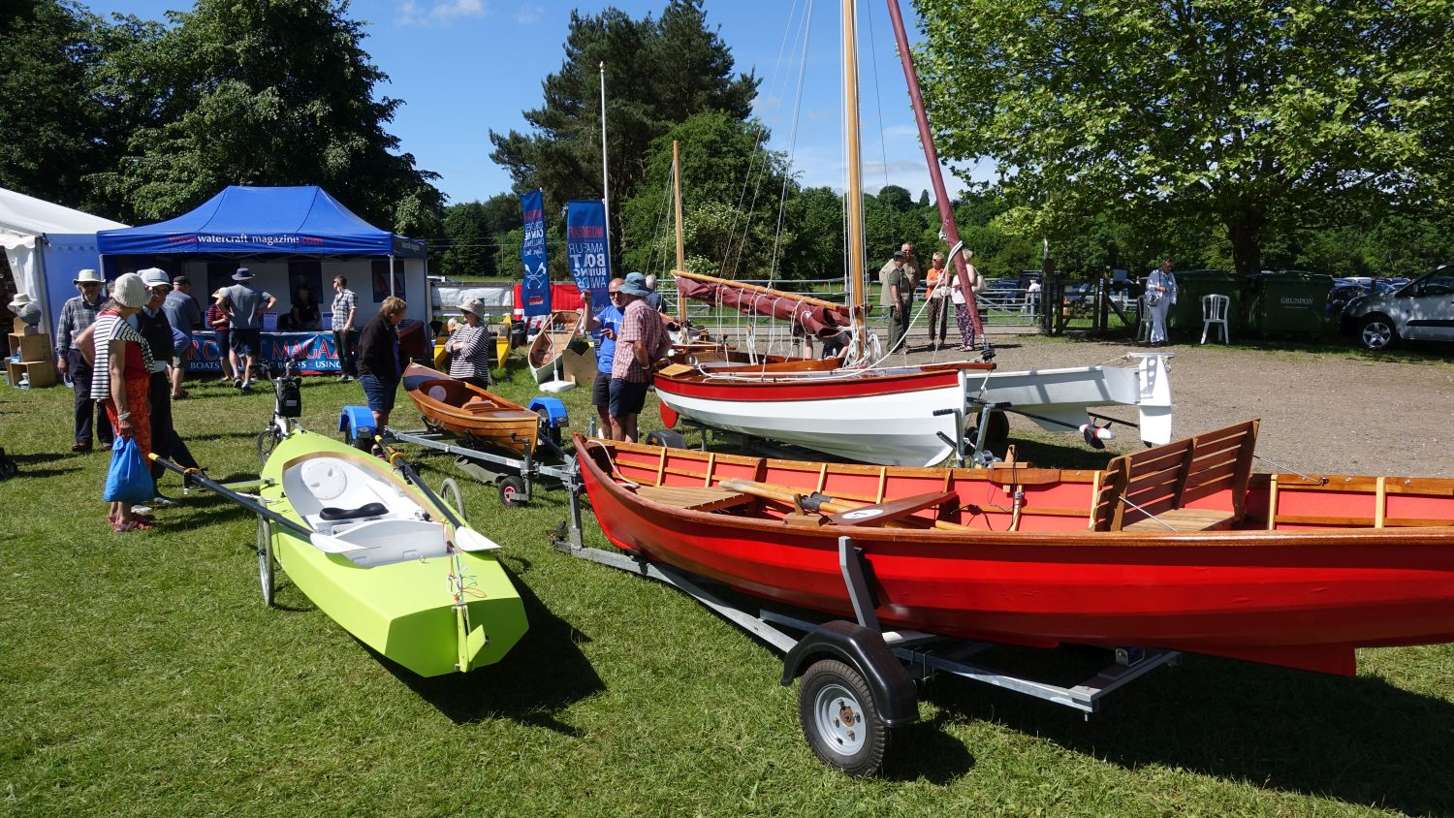
Beale Park – boat building awards – there were four prizes and four boats entered so everyone was happy!

Slide 29
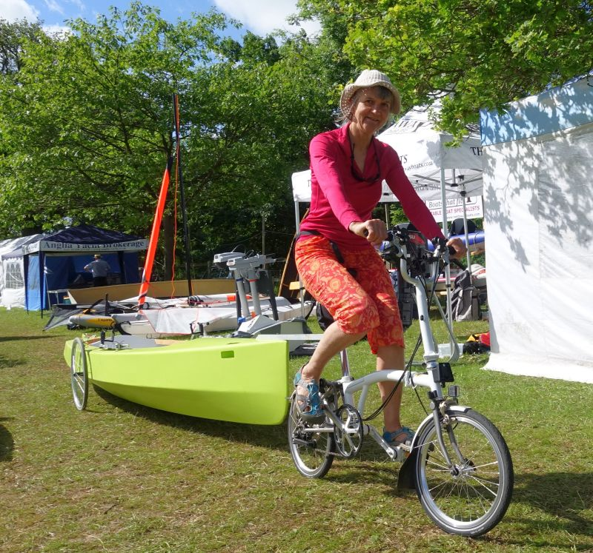
Demonstrating bicycle towing at Beale Park – easy on the level!
The folding bicycle can be carried on board the boat.
The coupling between boat and bicycle is a tiller extension joint made for racing dinghies

Slide 30
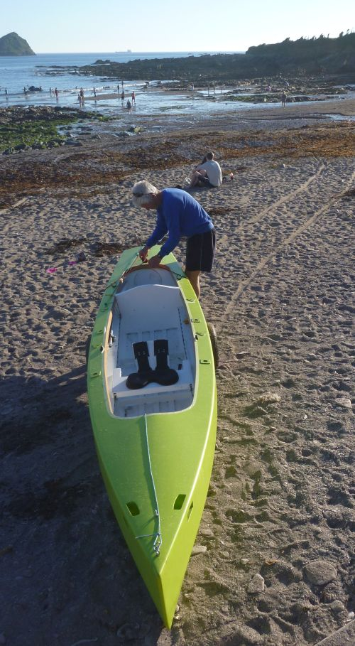
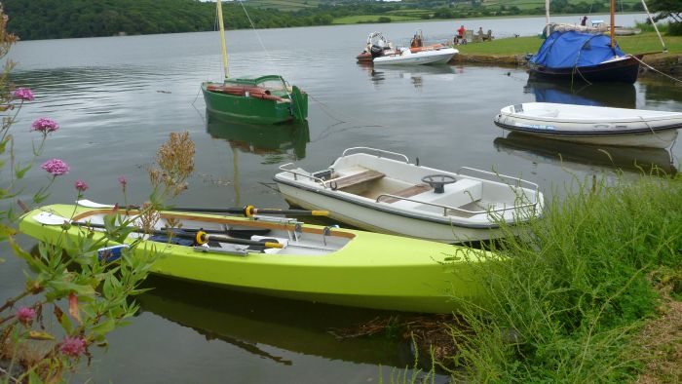
DCA Rally – Bere Ferrers on R. Tavy
In the background is a Paradox miniature cabin boat (green) and a Welsford navigator dinghy (dark blue)
At a local beach (with the conventional launching trolley which works better than the thin tyres on soft sand) Holes in bow are grab handles.

Slide 31
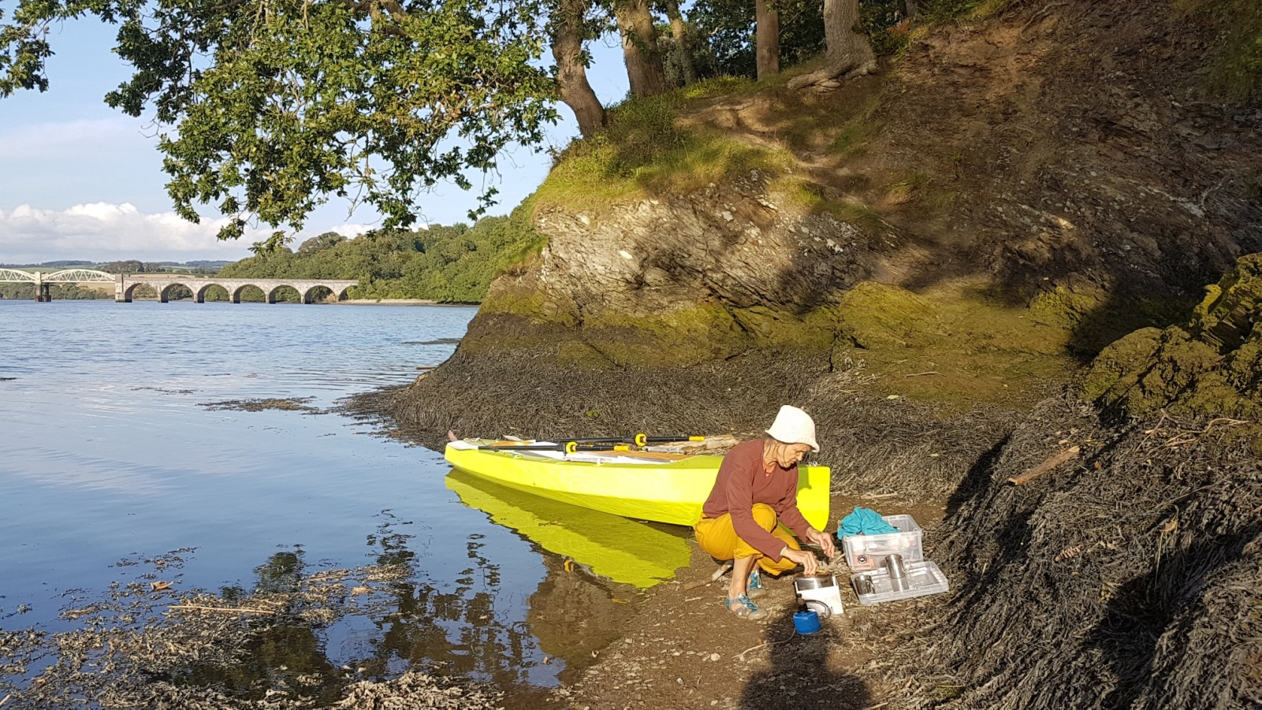
Refreshments stop - R. Tamar near Tamerton Follet

Slide 32
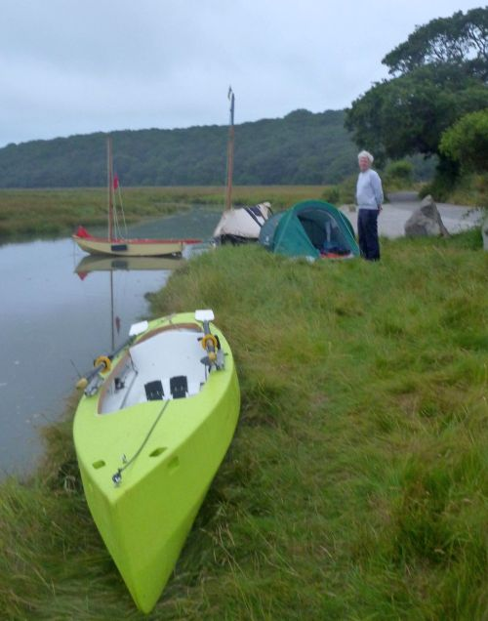
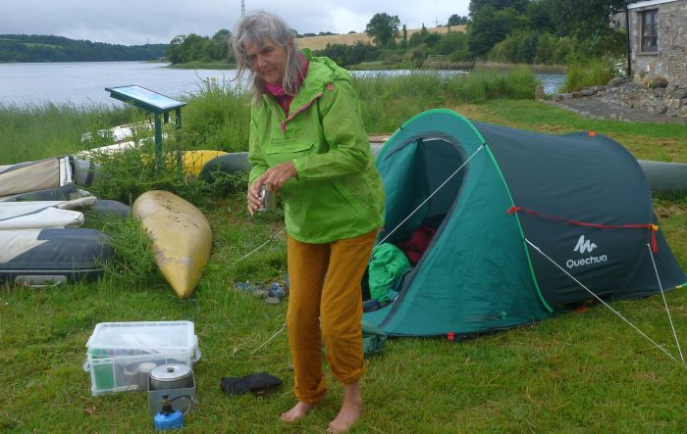
DCA Rally at Ruan Lanihorn (upper extremity of the tidal Fal)
Camping at Bere Ferrers – we had permission to camp on this small waterside green space near the pub

Slide 33
Things that did not work out so well:
Problems in the construction were all due to one or other of the following:
Not giving enough thought/checking at the final design stage
Not bothering to exactly follow the 3D drawings
Thinking that alterations/additions to the design could be made without going back and updating the drawings
The idea of towing this size of boat behind a bicycle is questionable – It could be done in flat country but would be hard work in Devon. It would certainly turn heads and I wonder what policemen might think about it. Also larger wheels (or a lower axle position) might be needed to give more ground clearance over speed bumps etc.
The sliding seat construction could be simplified and made to run more quietly. (metal wheels on metal runners are a bit noisy – like a train)
A purpose made frame was constructed to support the boat during assembly, this was not particularly helpful since it was found that assembly could be done just as well on any flat work surface.

Slide 34
Some things that worked out well - Construction:
Water jet cutting enabled an unskilled woodworker to produce a precise structure quickly. Computer controlled routing seems unlikely to produce much better results and is probably more expensive.
3D computer drawing allowed the fit of all parts to be checked and accurate cutting files to be produced. It helped in evaluating the aesthetics to be able to view the boat from all angles and quickly compare alternative designs.
3mm plywood with a light glass/epoxy external sheathing is adequately strong for this type of boat. Worth buying the best quality marine plywood.
The finger joints between panels are easy to assemble, neater than butt blocks and seem to be as strong as scarf joints. Pre-cut ‘marker holes’ enabled accurate alignment of the panel sections.
Assembling the stem timber as waterjet cut laminations produced an accurate shape quickly.

Slide 35
Some things that worked out well – In use:
The folding outriggers work well – quick to fold and unfold coming into locks or up to quaysides. No need to remove oars from rowlocks when folding. Do not obstruct the interior of the boat when folded. Easy to take off the boat for transport/storage.
The clip on wheels are brilliant for moving the boat from carpark to water and are usually carried on board for beaching the boat for picnic stops. A heavier duty launching trolley was also made for the boat and does work better than the thin wheels on soft beach sand.
The steering arrangement with a lifting rudder works well now that a larger rudder blade has been fitted. We are considering a ‘wing mirror’ for the passenger (also the cox) to see ahead.
The transom stern gives a bit of extra pitch stability, allows a spacious storage compartment aft and makes the boat easy to launch in shallow water. It may however have marginally higher drag than an equivalent canoe or ‘Whitehall’ stern.
The storage arrangements work well – there is space for camping equipment, clothing, provisions for a long river trip – Thames? Rhine? Danube?
Carrying on car roof rack is practical with ‘runners’ between boat and roof rack together with a roller fitted to the roof rack. The ‘Runners’ do need modification now we have a new car.

